Slide 1


Congratulations!
Thanks to extreme creativity, innovation and teamwork that your team has shown, you’ve earned a spot at Global Finals!
Global Finals is the world’s largest celebration of creativity. This year, more than 8,000 of the world’s most innovative students will come together to showcase Challenge solutions, collaborate, grow and have fun.

Slide 2



Slide 3
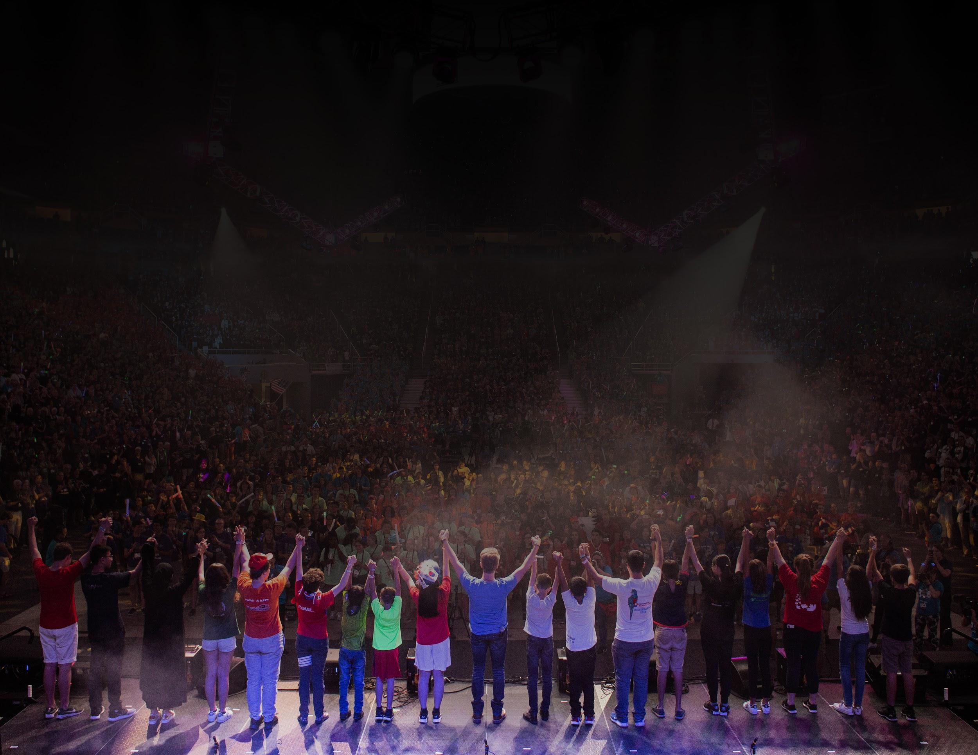
Global Finals 2019
What to Expect...
Global Finals is something you need to experience firsthand to truly understand. And this year, with our move to Kansas City, MO it will be an experience you definitely do not want to miss. Celebrate the 2018-19 DI season surrounded by more than 17,000 attendees and one-of-a-kind events that celebrate creativity, foster curiosity, inspire confidence and encourage collaboration in a high-energy, family-friendly, and multicultural atmosphere.

Slide 4




Global Finals Resources
Online:
GlobalFinals.org
Email:
askdi@dihq.org
Phone:
1.888.321.1503

Slide 5

Global Finals Resources
Global Finals Guide
Each Team Manager and parent will receive this essential guide which highlights registration, payment and cancellation information, prop shipment details, safety tips and activities.
This will be available in print format at the Affiliate Tournament as well as an interactive download at GlobalFinals.org.

Slide 6



Preparing for Global Finals
Registration
Register your team online as soon as possible. All registrations and payments must be completed by Wednesday, May 1, 2019.
Housing & Food
Housing & Food will be purchased separately from Team Registration.
There will be a wide variety of housing accommodations and dining options in Kansas City to meet each team’s needs and budgets.
The official hotel room block will be released to qualifying teams through a link in online registration.
Food options include pre-ordered meals, on-site concessions, and all the restaurants & grocery stores Kansas City has to offer.
Travel
Book your travel according to your arrival and departure
plans at Global Finals.
Tournament starts Wednesday and Closing Celebration
is Saturday at 4 PM

Slide 7


Sponsorships & Fundraising
Fundraising is an essential part of your team’s journey to attend Global Finals. From finding community sponsors to hosting bake sales, we’ve put together a comprehensive list of fundraising activities and events for teams in the Global Finals Guide.
Sponsorships
To assist teams in gaining sponsors, helpful resources are available on the Global Finals website.
Team Sponsor Pitch Presentation is an editable PowerPoint that can be used to approach potential sponsors.
Fundraising Template is an editable letter that is an introduction letter to potential sponsors.
Donors can give to DI HQ on your team’s behalf. If your team is not affiliated with a school or organization that is a certified non-profit, donors can give to DI Inc (a 501c3) and their donations will be applied to your team’s registration fee balance. For details see https://www.globalfinals.org/sponsor-a-team/.
Need-Based Financial Assistance
In an effort to assist teams in affording the opportunity to attend Global Finals 2019, DI has established a small assistance fund for teams that show need.
More information and the application are available at https://www.globalfinals.org/team-resources/
Fundraising
Fundraising events are another way that your team can consider getting additional support.
The Global Finals Guide has a comprehensive list of great ideas your Team can
implement to raise financial support.

Slide 8

Team Registration
The Global Finals event registration fee will allow each team to participate in a Global Finals unlike any before. Each team will be able to register unlimited supporters and choose the food and lodging accommodations that best suit their individual needs.
Pricing
Price Per Team is $5,500 with a deposit of $1,500 due within two weeks of the team’s Affiliate Tournament, which is April 13th for Maryland.
Registration fees include:
Unlimited credentials per Team
Guarantee of up to 10 tickets for Welcome Ceremony and Closing Celebration,
with overflow viewing available.
Full participation in Team Challenge & Instant Challenge portions
Individual Prop Storage Exhibit Space
Free Workshops
Daily & Nightly Special Events throughout the week

Slide 9







Payment Process
Step 1
Affiliate Directors certify eligible teams to attend Global Finals.
Step 2
Team Managers receive an email which will direct them to accept or decline their invitation to Global Finals.
Step 3
Team Managers register online and pay a $1,500 deposit. This must be completed by April 13th for Maryland teams. A balance is permitted to be carried to the event, but registrations paid in full by May 1 will be eligible for express registration on-site.
Step 4
The deadline for Team Managers to register names of all Global Finals attendees is May 1, 11:59 p.m. EST. Please note that any additional attendees who register after May 1 will be able to register on-site with a valid ID and Team Number for a $25 processing fee.
Step 5
Download and complete online forms and bring them to Global Finals. You must have a consent form to receive a credential.
Use the Forms Checklist in the Global Finals Guide.

Slide 10

Registration Deadlines
The most important date to remember is Wednesday May 1, 2019. This is the deadline for all Global Finals services, including online registration, credential signups, pre-ordered food selections and hotel blocks.
Changes
Changes can be made to team registrations until May 1, 11:59 p.m. Eastern Time. To avoid all additional penalties, all team registrations must be completed by this date.
Late Registration
If the team registers after May 1, 11:59 p.m. Eastern Time, there will be an additional $500 penalty. Registration fees, including the additional $500 penalty, must be paid immediately and in full.
Late registrations and changes must be submitted by the Team Manager via e-mail to askdi@dihq.org or by fax at 856-881-3596. Penalties, as previously described, will apply.
Credentials After the Deadline
If a team needs additional credentials that are not entered through online registration
by May 1, there will be a $25 processing fee per credential and proper forms and
identification will be required on-site. More information about this protocol will be
available on GlobalFinals.org under Registration. To avoid significant wait times on
site and additional fees, please have all attendees registered before May 1.

Slide 11

Team Cancellations
If the team cancels before May 1, 11:59 p.m. Eastern Time, Destination Imagination will refund 50% of the $1,500 deposit (i.e., $750).
Starting May 2, no refunds will be issued for cancelled teams.
If the deposit is not paid by May 1, 11:59 p.m. Eastern Time, the team will automatically be cancelled and Team Late Registration rules will be enforced if the team would like to be reinstated.
Refunds for cancellations prior to May 1, 11:59 p.m. Eastern Time will be processed 6 to 8 weeks after the event, less cancellation fee of $750. Cancellation fees are not transferable.
Late cancellations must be submitted by the Team Manager via e-mail to askdi@dihq.org or by fax at 856-881-3596. Penalties, as previously
described, will apply.

Slide 12



Props
This year’s Prop Storage experience is brand new! Each team will have a designated Prop Display Booth, organized by Challenge for the entirety of the event as a place to display props or meet as a team.
Prop Valet
This year we will be offering delivery of your props by a Destination Imagination Global Finals Prop Valet service! Prop Valet will deliver all pre-shipped props to each Team’s designated Prop Display Booth.
Prop Display Booths & The Prop Storage Exhibit Hall
Each team will get an assigned 8ftx8ft Prop Display Booth in the brand new Prop Storage Exhibit Hall. In the hall we will also offer Garages where teams can plug in their tools and make last minute adjustments to their props.

Slide 13

Prop Shipping & Delivery
Teams may hand-deliver their props to their Prop Storage booth or use our Prop Valet service at no extra cost.
Prop Shipment
We encourage teams to ship or deliver their props in advance to avoid long vehicle wait times to unload on site. If you ship in advance, your props will be delivered no later than 5:00 p.m. CT Tuesday, May 21 to your team’s dedicated Prop Storage booth.
Driving Your Props (Hand Delivery)
If you plan to drive your props to the site and unload, please make sure to indicate that when you register for Global Finals. Teams that plan to unload their own props will be provided directions to Prop Storage when they register on-site. All teams must receive credentials before unloading.
Credentials, received by a Team Manager at registration, will be required to access Prop Storage.
Detailed Prop Shipment Hand-Delivery guidelines can be found at https://www.globalfinals.org/prop-info/

Slide 14
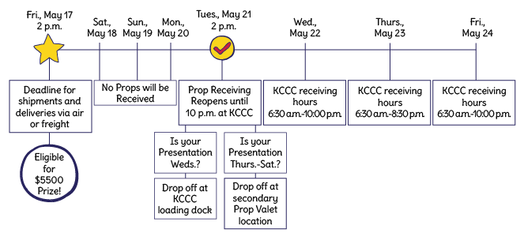
Prop Shipment Timeline

Slide 15
Housing & Food
Event Room Blocks & Hotel Information
Teams will have the freedom to choose their preferred housing accomodations.
Official event room blocks in various hotels will be booked through one dedicated booking system.
Rooms will vary in location, amenities and price.
Other Housing Options
Teams may also stay at hotels outside of Destination Imagination’s official event room block or utilize other accommodations like Airbnb and VRBO.
Pre-Ordering Meals
Teams can choose to pre-order all, some or none of their meals.
Menus are available on GlobalFinals.org and pre-ordering can be accessed through a link provided during online registration.
Breakfast and dinner will be buffet-style and lunch will be boxed.
Dietary restriction options will include kosher, halal, vegan, vegetarian,
gluten-free and nut-free.
Paid for with credit card or purchase order in advance.
Other Meal Options
On-site concessions (menus available at GlobalFinals.org)
Local restaurants and grocery stores

Slide 16
Things To Do Before Global Finals
#1
Registration Deposits
• Register and make
$1,500 deposit
within 2 weeks
#2
Registration Payment
• Pay Team Registration Fees in full by May 1
to qualify for Express Check-In in KC
#3
Registration Forms
• Consent Form
• On-Site Contact Form
#4
Housing & Food
• Book Team Hotel
• Pre-Order Food
(if needed)
#5
Affiliate Orders
• Pin Orders
• Shirt Orders
#6
Prop Shipment
• Get Booth Number
• Use DI Provided Labels
• Props Should Arrive
by May 17, 2019
For Prop Valet

Slide 17
Tournament Schedule
During online registration, your team may make special requests for scheduling. While DI will make every effort to accommodate your team’s request, no special requests are guaranteed.
Teams’ Instant and Team Challenges will be scheduled on separate days.
The tournament schedule will be available approximately 10 days prior to Global Finals. Check GlobalFinals.org to find the complete schedule after release.

Slide 18
Affiliate Merchandise
Affiliate T-Shirts
Affiliate Shirts are strongly recommended for all participants. Wearing an Affiliate T-Shirt is one of the best ways to represent your state or country at Global Finals!
Each Maryland team member and manager will receive a coupon entitling them to purchase a t-shirt for $1, which basically covers the drop ship charge. Additional shirts can be purchased for supporters for $12.25 - $14.25, depending on size.
Affiliate T-shirts can be purchased at www.MarylandDI.org/shop beginning April 8th.
Maryland shirt order deadline is April 20th.

Slide 19

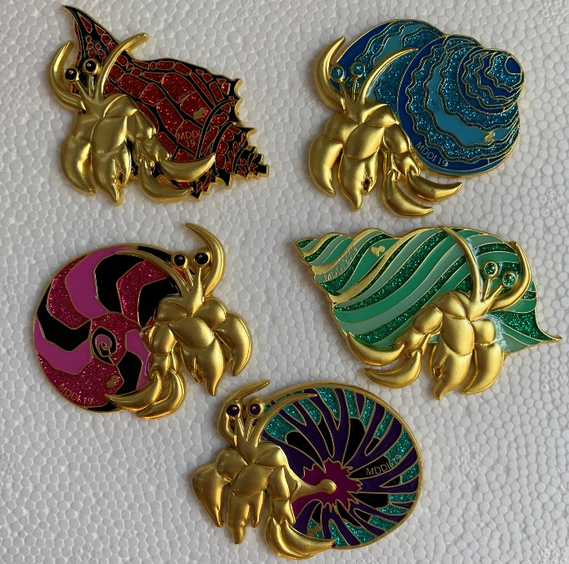


Affiliate Pins
DI affiliates produce pins for their participants to trade with people from all over the world. This year Maryland has four sets available for our teams.
Maryland pins can be purchased at www.marylanddi.org/shop

Slide 20
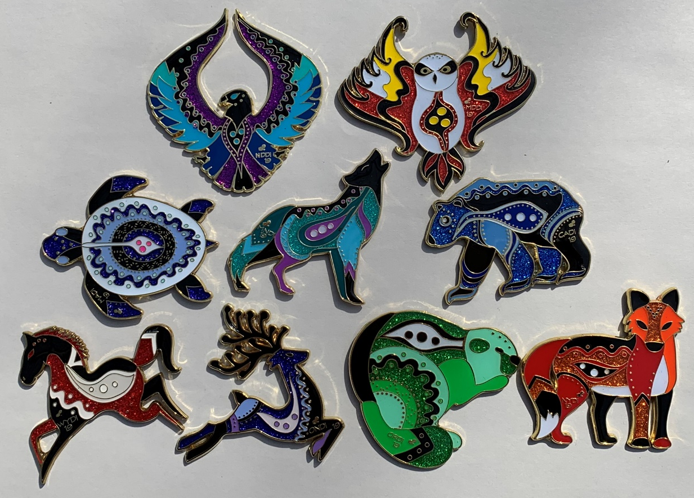
Affiliate Pins
Multi-Affiliate
Animal Set
Maryland is taking part in this set that features animals that are native to the affiliates. The only way for Maryland teams to get their hands on these pins prior to Globals is to purchase our other three sets. We have 500 MD owl pins and some N Dakota eagles and Ontario deer pins. For every 5-set pack of our other pins purchased we will include one of these pins. We cannot guarantee which pin will be included.

Slide 21

About the Special Pins
This colorful pink crab is a special addition to the base 4-piece crab set. This pin will be given by Sally Gold, Sharon Munns and their representatives to team members and siblings who show up to support Maryland DI teams that perform prior to 9:00 a.m. on any day at Globals as long as supplies last. After 9:00 a.m. on Friday, they will also be trading these for pins to stock next year’s raffle hats, so supplies on Saturday morning could be limited. There are only 500 of these pins, so they will be rare and sought after.

Slide 22
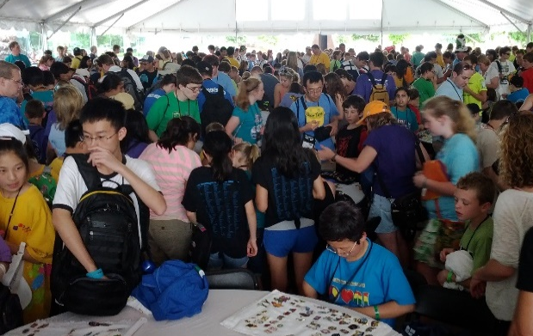
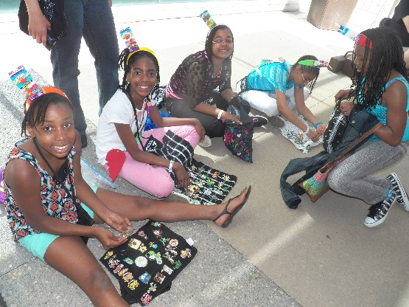
Don’t underestimate the power of pins.
Pin trading is a great way to
meet people from around the world
develop self-confidence & negotiation skills
remember the Globals experience for years to come.
Pin and shirt order details:
Shirt order deadline is April 20th.
Pin purchase deadline is May 1st.
Two order limit per team. No individual orders.
One payment per order by check or credit card. Credit card preferred.
Sold on first come, first served basis.
Pins may sell out before deadline. (They did last year)
Minimum number of pins recommended: 50 per child (don’t forget siblings)

Slide 23

Arrival Procedure
One of your first stops in Kansas City will be at Municipal Arena for Global Finals 2019 on-site registration. This is where you will pick up your team’s credentials and can get any questions answered about your prop shipment and Prop Storage location.
Registration Times for each day are as follows:
Tuesday, May 21 - 12:00 p.m. - 10:00 p.m.
Wednesday, May 22 - 7:00 a.m. - 8:00 p.m.
Thursday, May 23 - 7:00 a.m. - 5:00 p.m.
Friday, May 24 - 7:00 a.m. - 5:00 p.m.
Saturday, May 25 - 7:00 a.m. - 4:00 p.m.

Slide 24
General Schedule
Monday:
• Arrivals (Credentials not available
until Tuesday)
Tuesday:
• Arrivals
• Team Manager Meeting @ 7 p.m.
Wednesday:
Tournament Begins
Welcome Ceremony @ 7:30 p.m.
Thursday:
• Tournament
• Box n’ Ballers Bash @ 7 p.m.
Friday:
• Tournament
• Rock the Dock
• Movie Night @ 7 p.m.
• Graduation @ 7:30 p.m.
Saturday:
• Tournament
• Rock the Dock
• Closing Celebration @ 4 p.m.
• Ice Cream Social @ 6 p.m.
Sunday:
Departures

Slide 25

Getting Around Kansas City
KC Streetcar - It’s free to ride!
Within walking distance downtown to many hotels, restaurants and destinations
Can transport teams from Convention Center to the Westin Crown Center for Instant Challenge
For a map of the Streetcar, see http://kcstreetcar.org/route/
Shuttles
Shuttles provided from select hotels in the room block to the Convention Center
Properties with shuttle service will be indicated as such on hotel booking site
Shuttle from Convention Center to Westin Crown Center for Instant Challenge will be provided
Walking
Downtown Kansas City is easily walkable with easy access to restaurants, hotel, the streetcar, the Kansas City Convention Center, the Sprint Center and Municipal Arena
Driving
Limited, free bus and car parking will be available at the Liberty Lot on a first-come, first-served basis. Shuttles will run from Liberty Lot to Convention Center.
For more information on getting around Kansas City,
please visit GlobalFinals.org.

Slide 26
Airport Shuttles &
Travel Discounts
Airport Shuttles from Kansas City International Airport
Some hotels will offer complimentary airport shuttles from Kansas City International Airport.
Please look on your hotel website for this information.
If your hotel does not provide a complimentary airport shuttle, Kansas City Transportation Group (KCTG) will offer reduced rate shuttles for Global Finals attendees. This will be available through a link provided during online registration. Taxis or ride share services like Uber and Lyft are also available.
Travel Discounts
Visit our Global Finals Travel Discounts page for discount information
Maryland DI has done some research as to flights out of the DC/Baltimore area. See www.marylanddi.org/globals for that info. We also provide some great tips for flying with kids.

Slide 27

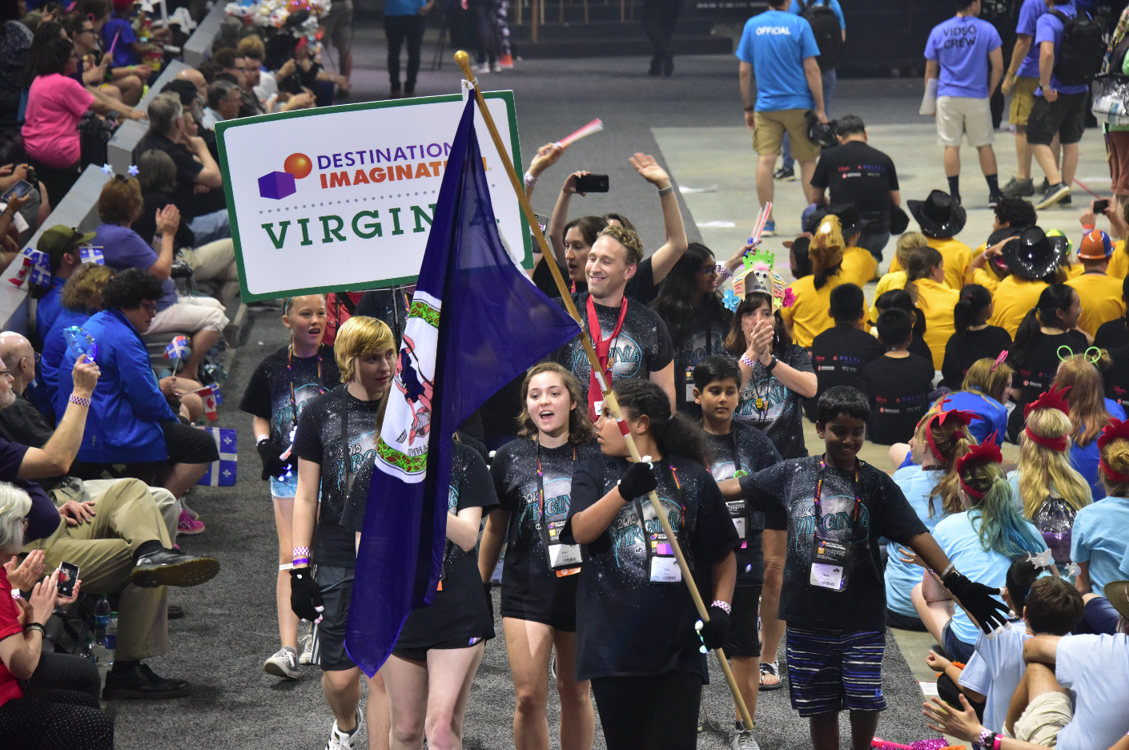
Welcome Ceremony &
Closing Celebration
Welcome Ceremony
Wednesday- 7:30p.m.
Welcome Ceremony is our official start to Global Finals. We celebrate you and all of your accomplishments, beginning with a parade and featuring thousands of cheering team members and spectators.
Closing Celebration
Saturday- 4:00 p.m.
We bring an end to Global Finals with a world-class celebration packed with thousands of cheering participants and fans. We’ll look back on your week at Global Finals and present awards and trophies!

Slide 28




Connect with Us
#GlobalFinals2019

Slide 29
Important Contacts
Affiliate Director: Sally Gold
Phone: 410-337-0591
Email: sally@marylanddi.org (preferred method of contact)
Affiliate Information:
www.marylanddi.org/globals

